Slide 1
Amazon Web Services (AWS)

Slide 2
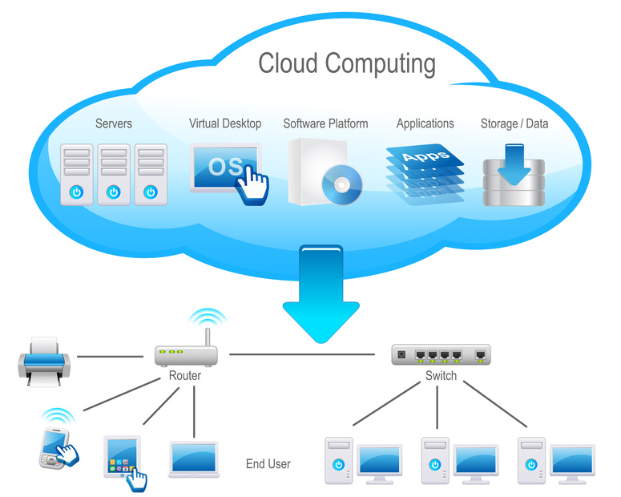
Amazon Web Services (AWS)
Cloud Computing

Slide 3
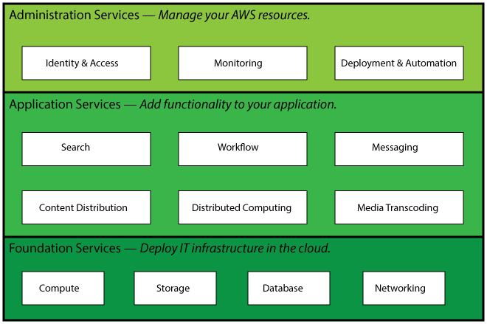
Amazon Web Services (AWS)
Amazon Web Services(AWS)

Slide 4
Amazon Web Services (AWS)
Common Uses of AWS:
Store files
Host a website
Run a database
Deploy an application
Create a Network
Manage My Resources

Slide 5
Amazon Web Services (AWS)
Run a Virtual Server on AWS (EC2)
Amazon Elastic Compute Cloud (Amazon EC2) are used to run and manage virtual servers on AWS.
Steps To Launch An EC2:
Open the Amazon EC2 console at https://console.aws.amazon.com/ec2/.
On the dashboard, click Launch Instance.
The Select an Amazon Machine Image (AMI) page displays a list of available AMIs. Select an AMI that is marked Free tier eligible. For the purposes of this tutorial, select the Amazon Linux AMI.
On the Select an Instance Type page, ensure that the t2.micro instance is selected, as this instance type is within the limits of the free tier.
Click Review and Launch to accept the default settings and let the wizard complete the rest of steps for you.
On the Review Instance Launch page, you can review the settings for your instance. When you are satisfied with your selections, click Launch.
In the Select an existing key pair or create a new key pair dialog box, select Create a new key pair, enter a name for it, and then click Download Key Pair. This is the only chance for you to save the private key file, so be sure to download it. Save the private key file in a safe place. You'll need to provide the name of your key pair when you launch an instance and the corresponding private key each time you connect to the instance.
When you are ready, select the acknowledgment check box, and then click Launch Instances.
It takes a few minutes for AWS to provision the server. When provisioning is complete, your EC2 instance appears in the EC2 console on the Instances page.

Slide 6
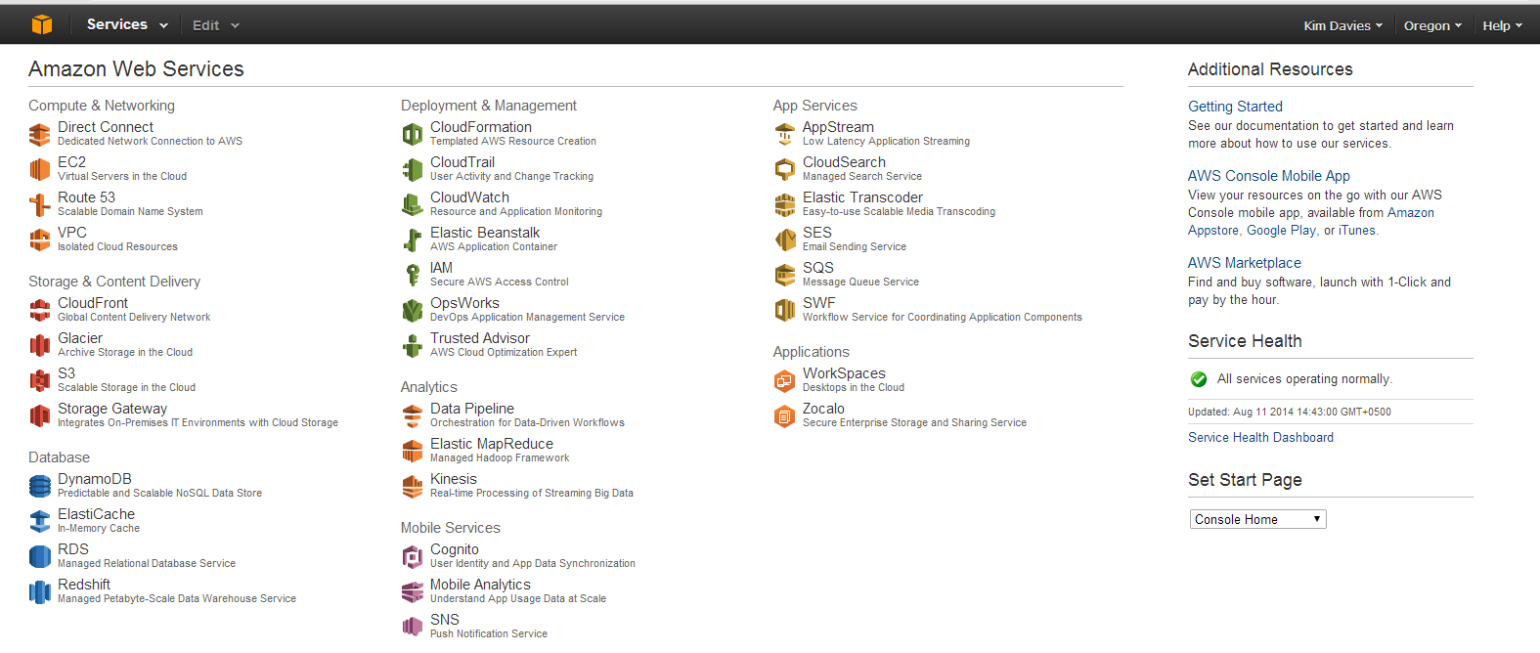
Amazon Web Services (AWS)
Picture Story

Slide 7
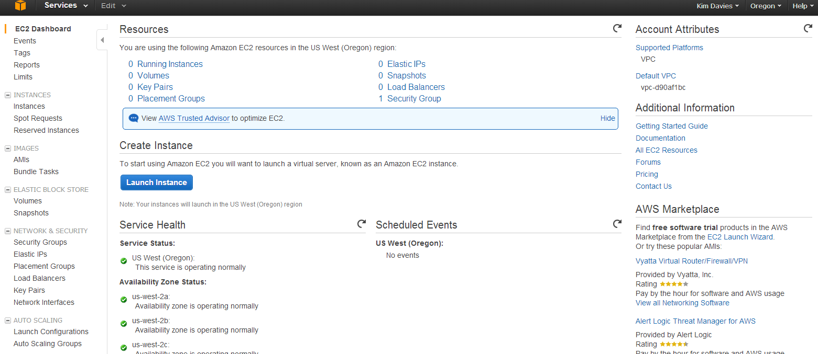
Amazon Web Services (AWS)
Picture Story Continues …

Slide 8
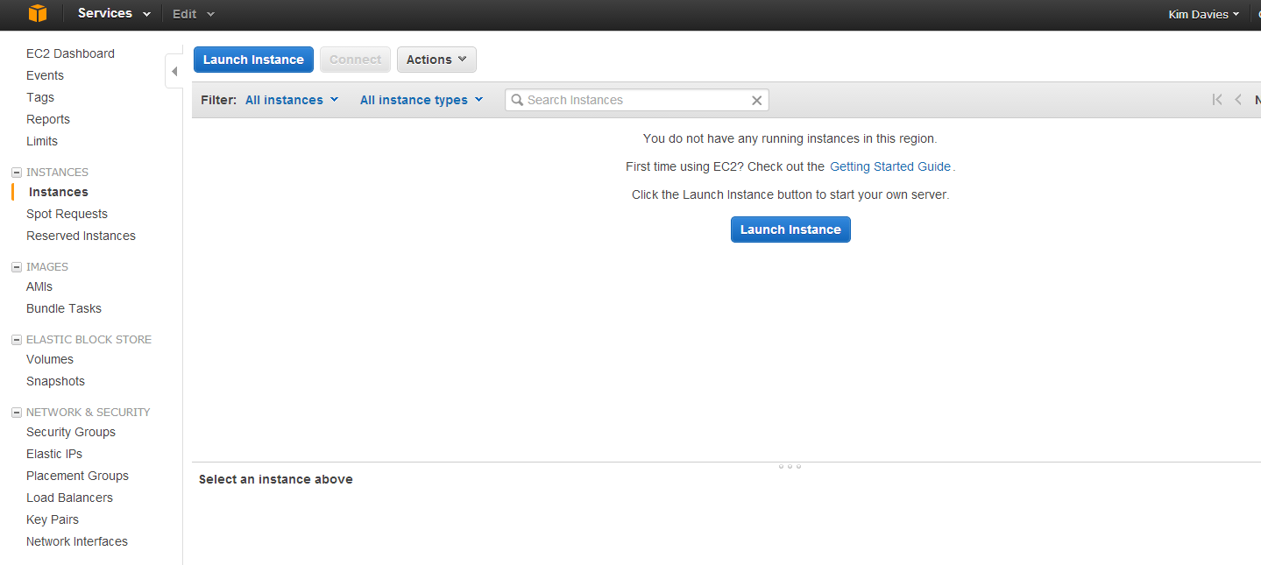
Amazon Web Services (AWS)
Picture Story Continues …

Slide 9
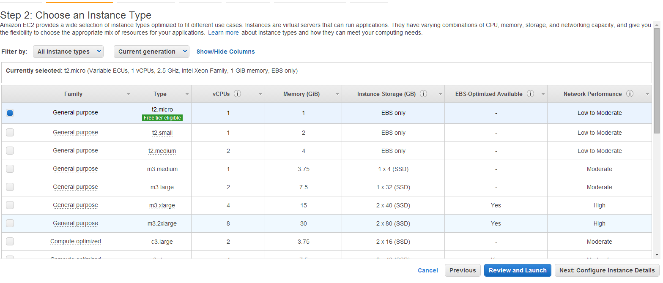
Amazon Web Services (AWS)
Picture Story Continues …

Slide 10
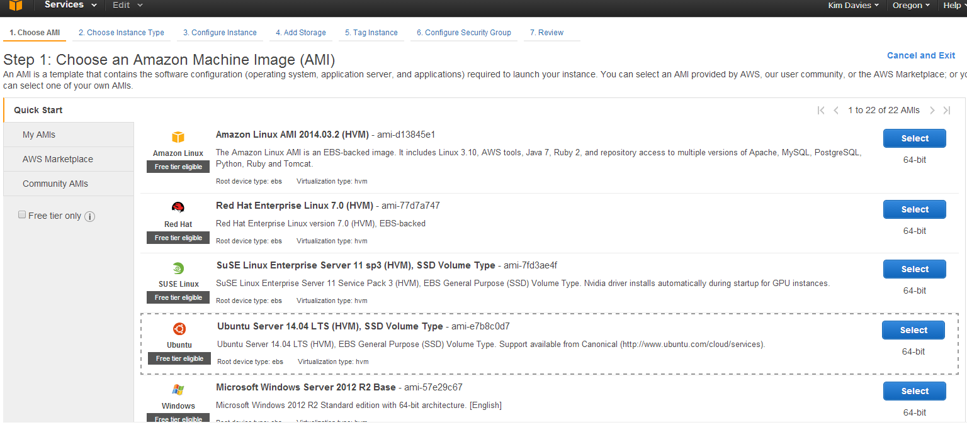
Amazon Web Services (AWS)
Picture Story Continues …

Slide 11
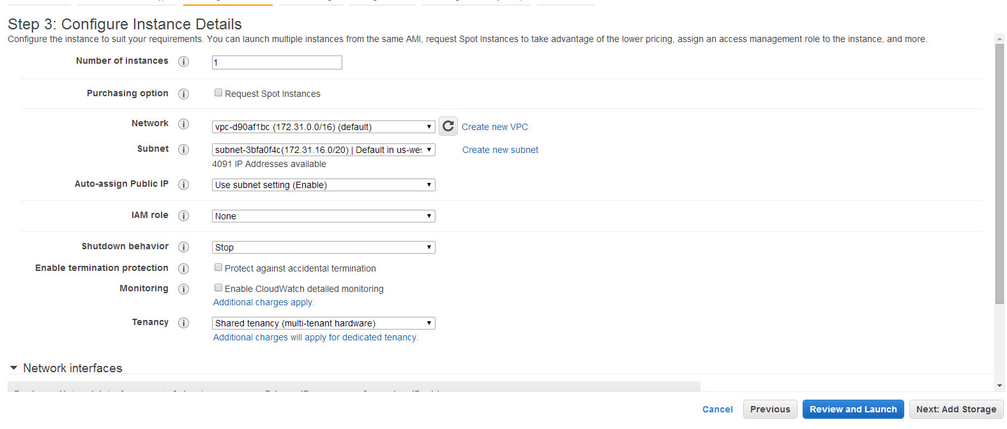
Amazon Web Services (AWS)
Picture Story Continues …

Slide 12
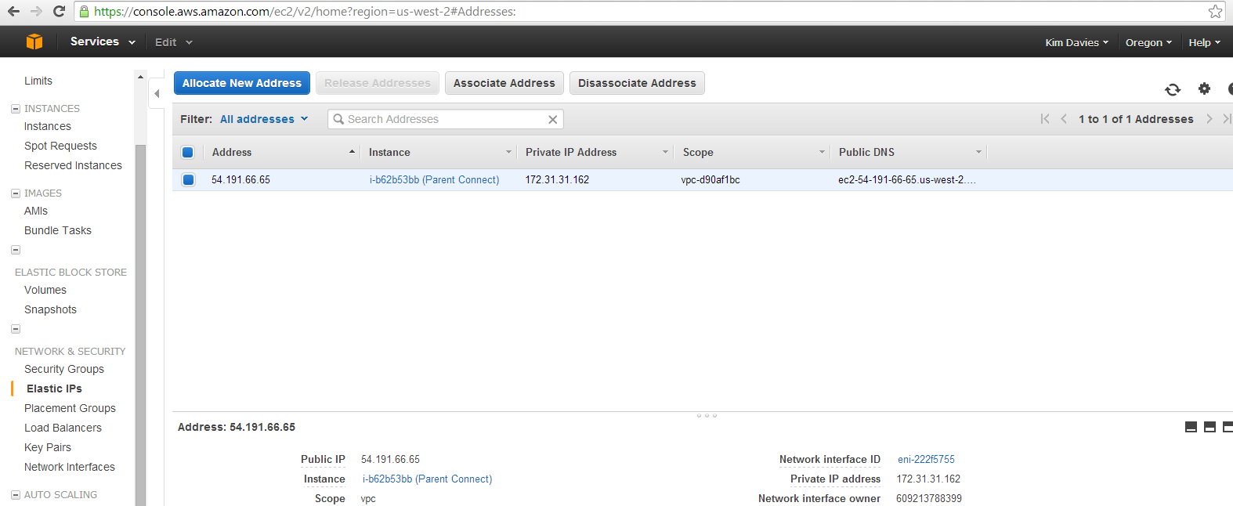
Amazon Web Services (AWS)
Picture Story Continues …

Slide 13
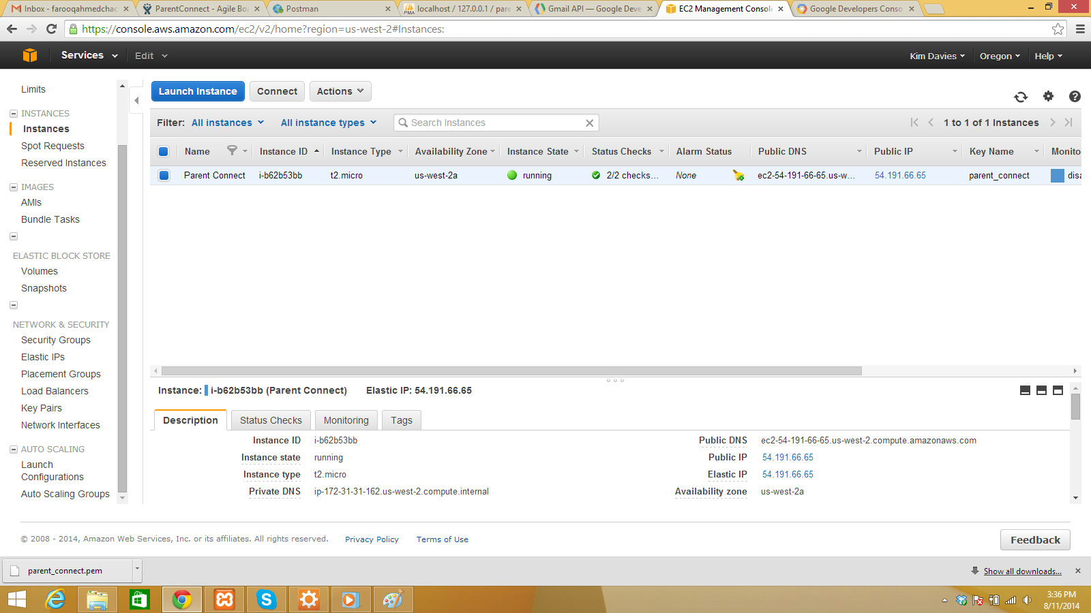
Amazon Web Services (AWS)
Picture Story Continues …

Slide 14
Amazon Web Services (AWS)
Auto Scaling:
Auto Scaling allows you to scale your Amazon EC2 capacity up or down automatically according to conditions you define. With Auto Scaling, you can ensure that the number of Amazon EC2 instances you’re using increases seamlessly during demand spikes to maintain performance, and decreases automatically during demand lulls to minimize costs. Auto Scaling is particularly well suited for applications that experience hourly, daily, or weekly variability in usage. Auto Scaling is enabled by Amazon CloudWatch and available at no additional charge beyond Amazon CloudWatch fees.

Slide 15
Amazon Web Services (AWS)
Elastic Load Balancing
Elastic Load Balancing automatically distributes incoming application traffic across multiple Amazon EC2 instances in the cloud. It enables you to achieve greater levels of fault tolerance in your applications, seamlessly providing the required amount of load balancing capacity needed to distribute application traffic.

Slide 16
Amazon Web Services (AWS)
Amazon Relational Database Service (RDS)
Amazon Relational Database Service (Amazon RDS) is a web service that makes it easy to set up, operate, and scale a relational database inthe cloud. It provides cost-efficient and resizable capacity while managing time-consuming database management tasks, freeing you up to focus on your applications and business.
Advantages:
Reliable ,Scalable,Cloud Support ,On Demand Instances support ,Secure

Slide 17
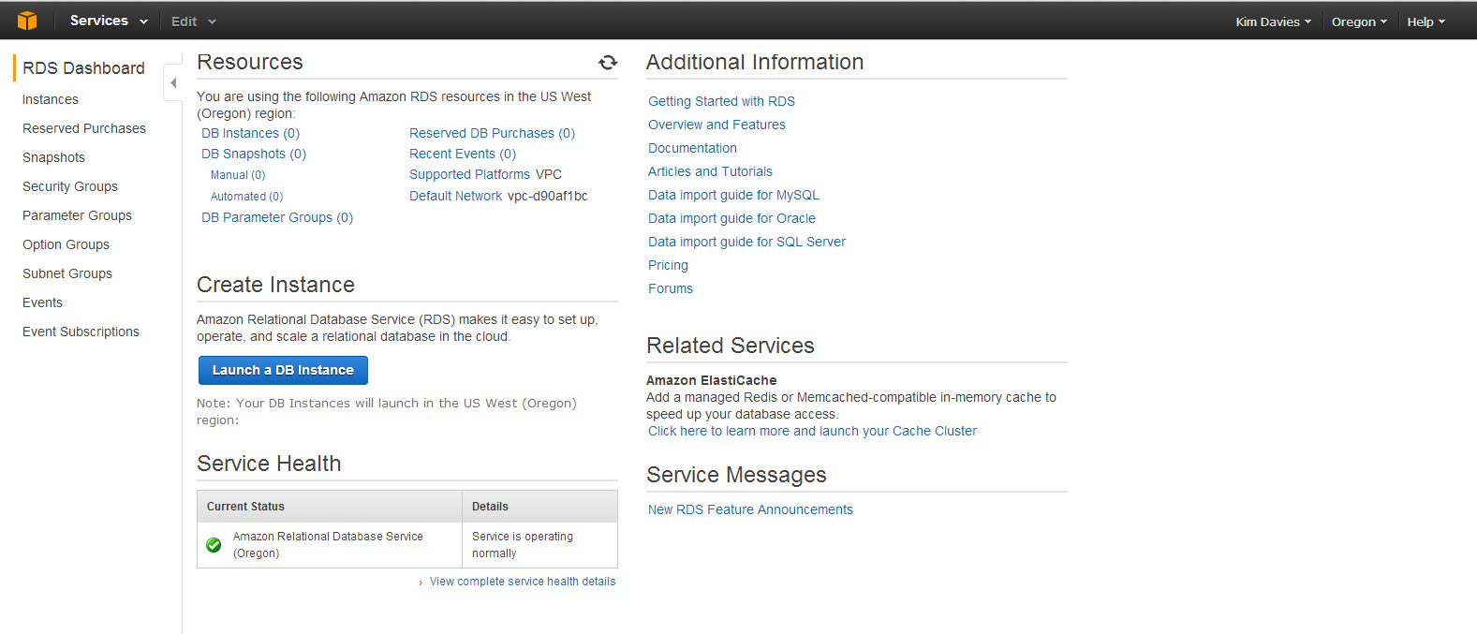
Amazon Web Services (AWS)
Steps to launch an RDS Instance:

Slide 18
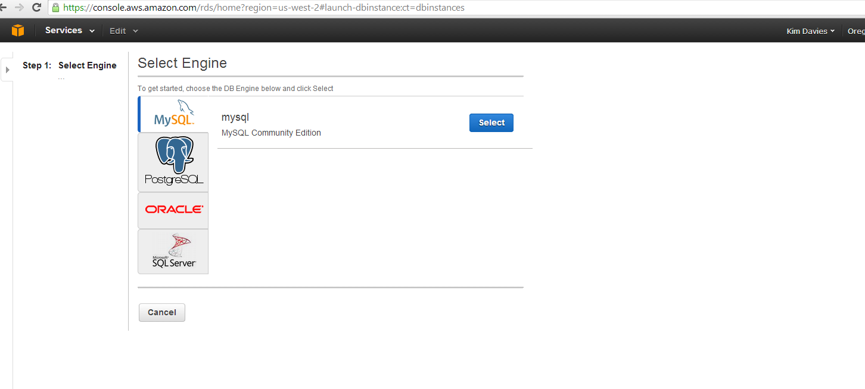
Amazon Web Services (AWS)
Picture Story Continues …

Slide 19
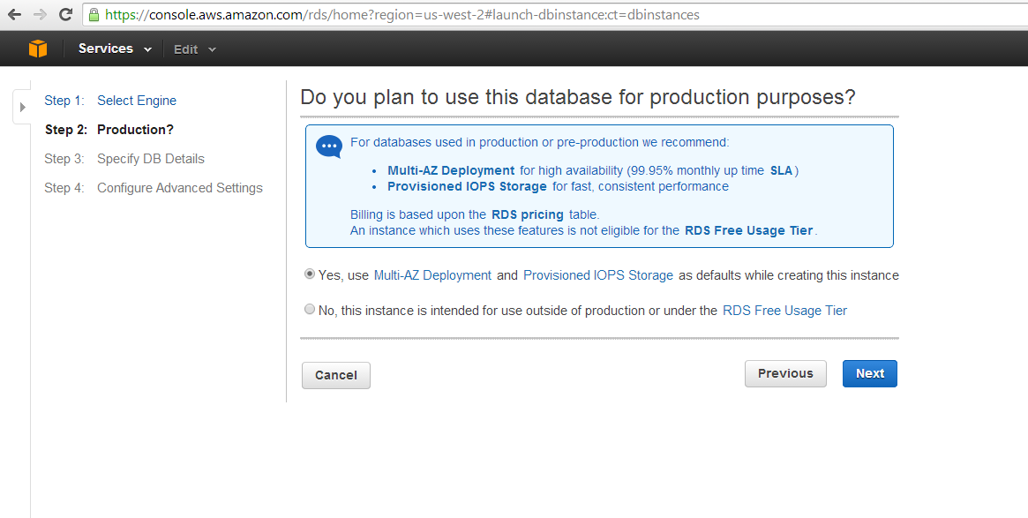
Amazon Web Services (AWS)
Picture Story Continues …

Slide 20
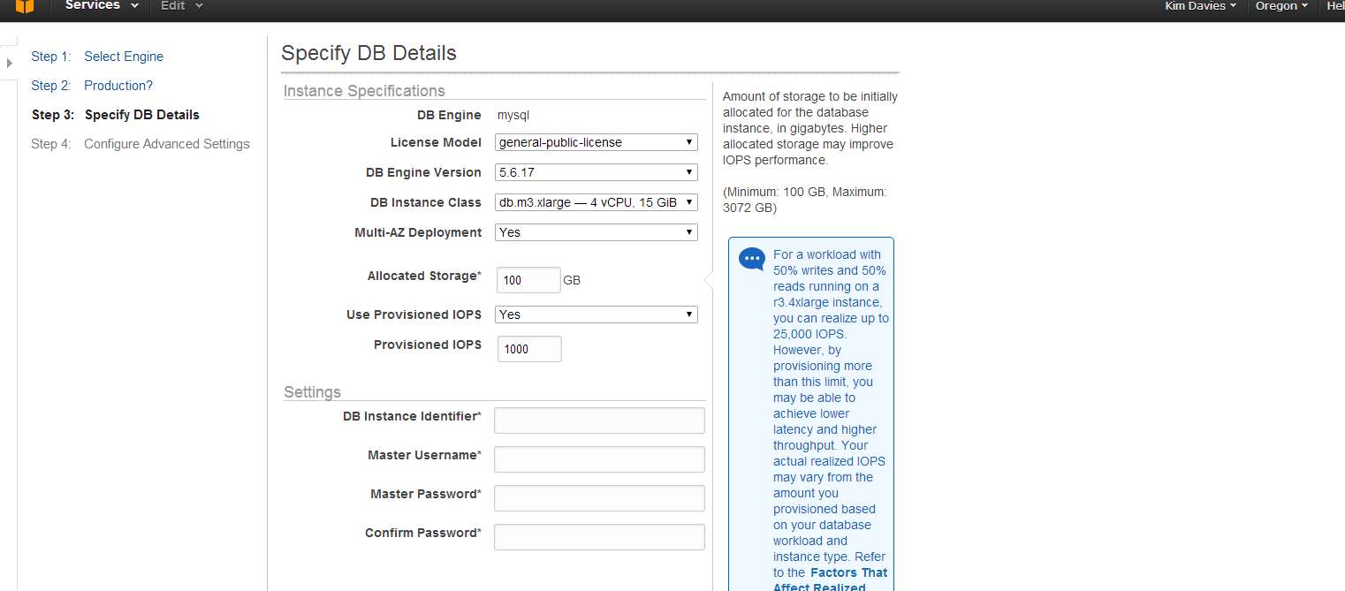
Amazon Web Services (AWS)
Picture Story Continues …

Slide 21
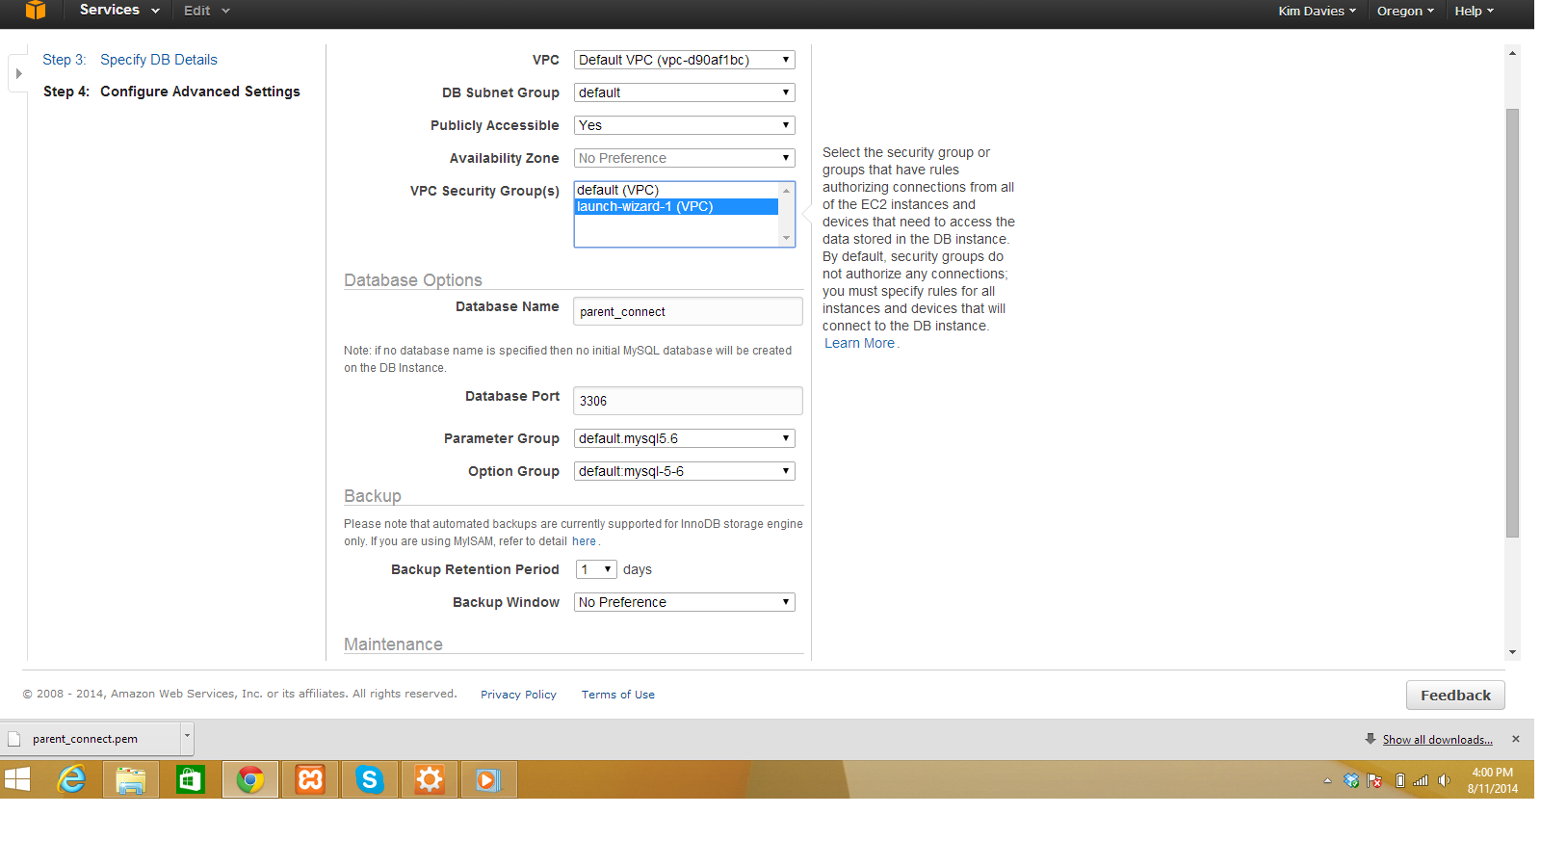
Amazon Web Services (AWS)
Picture Story Continues …

Slide 22
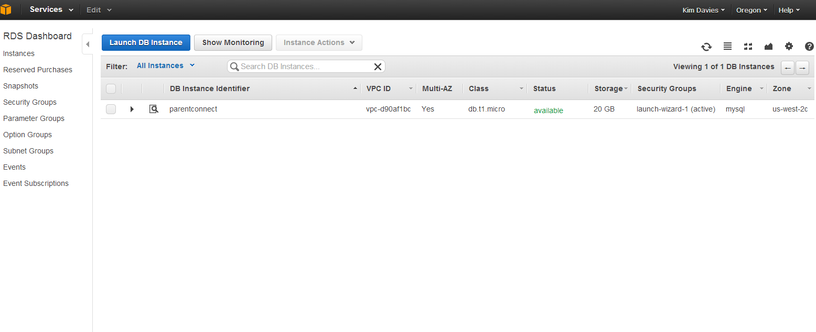
Amazon Web Services (AWS)
Picture Story Continues …

Slide 23
Amazon Web Services (AWS)
Amazon Simple Storage Service (S3)
Amazon S3 is cloud storage for the Internet. It is designed to make web-scale computing easier for developers.
Amazon S3 provides a simple web-services interface that can be used to store and retrieve any amount of data, at any time, from anywhere on the web. It gives any developer access to the same highly scalable, reliable, secure, fast, inexpensive infrastructure that Amazon uses to run its own global network of web sites. The service aims to maximize benefits of scale and to pass those benefits on to developers.

Slide 24
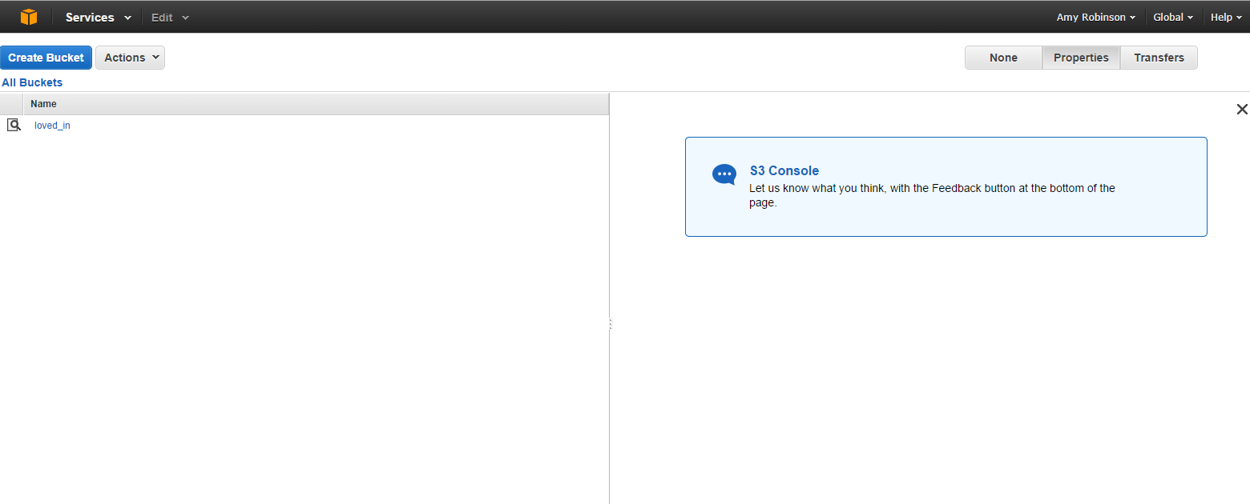
Amazon Web Services (AWS)
S3
A Running Bucket

Slide 25
Amazon Web Services (AWS)
Any Question ????

